Slide 1
Special Neural Network
Dr. Bhakti Palkar

Slide 2
Syllabus
Special Neural Networks 08 CO3
4.1 Cognitron, Neocognitron, Boltzman Machine, Gaussian Machine, Simulated Annealing, SVM
#Self-Learning: Benefits of Multi-layer Neural Network

Slide 3
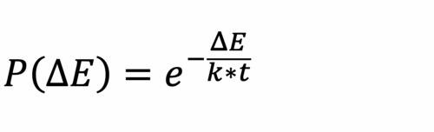
Simulated Annealing
The Simulated Annealing algorithm is based upon Physical Annealing in real life. Physical Annealing is the process of heating up a material until it reaches an annealing temperature and then it will be cooled down slowly in order to change the material to a desired structure.
When the material is hot, the molecular structure is weaker and is more susceptible to change.
When the material cools down, the molecular structure is harder and is less susceptible to change.
Another important part of this analogy is the following equation from Thermal Dynamics:
3

Slide 4
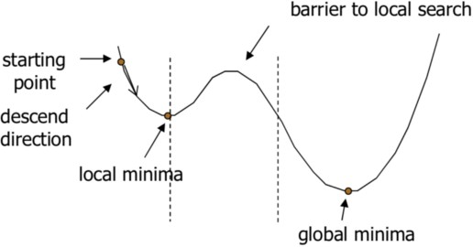
Simulated Annealing (cont.)
Simulated Annealing (SA) mimics the Physical Annealing process but is used for optimizing parameters in a model.
This process is very useful for situations where there are a lot of local minima such that algorithms like Gradient Descent would be stuck at.
4

Slide 5
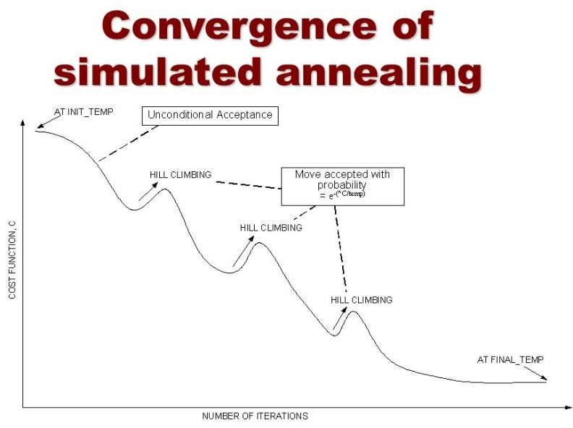
Simulated Annealing (cont.)
Example – Stone and Hill (Textbook-Shivnandan)
Fig- Reference - https://dev.to/swyx/unsupervised-learning- randomized-optimization-d2j
4

Slide 6
Boltzmann Machine
When simulated annealing is applied to the Discrete Hopfield network then it becomes Boltzmann machine.
It consists of as set of units Xi and Xj and set of bidirectional connections between pairs of units. Also, contains wij not equal to 0.
This machine can be used as an associative memory then, wij = wji. Self-connection on weights also exist.
For unit Xi, state xi may be 0 or 1.

Slide 7

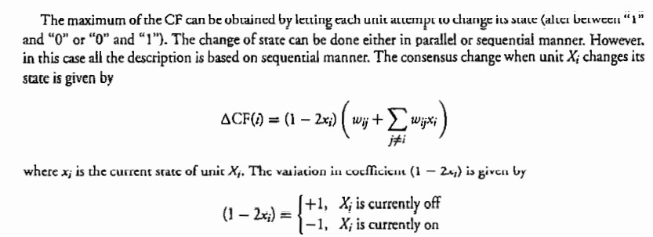
Boltzmann Machine
Objective is to maximize Consensus Function (CF);

Slide 8
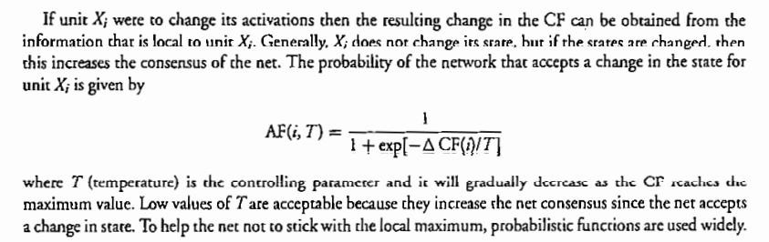
Boltzmann Machine

Slide 9
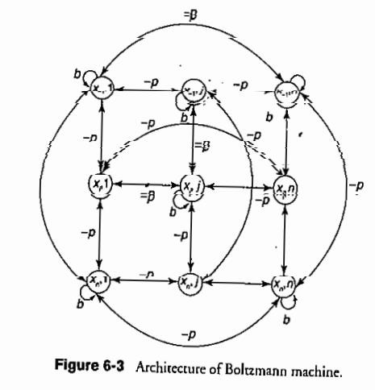
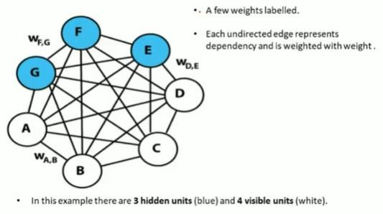
Boltzmann Machine Architecture

Slide 10
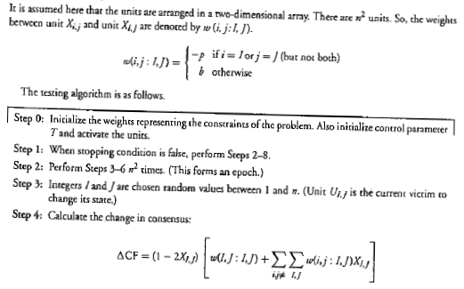
Boltzmann Machine Algorithm

Slide 11
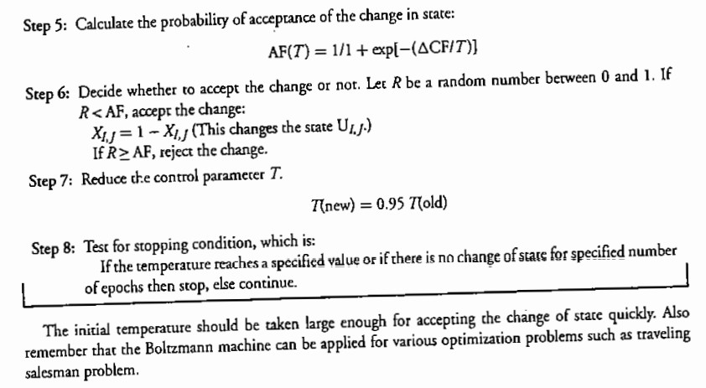
Boltzmann Machine Algorithm

Slide 12
Gaussian Machine
Gaussian machine is one which includes Boltzmann machine, Hopfield net and other neural networks.
Gaussian machine is based on the following three parameters: (a) a slope parameter of sigmoidal function (alpha) (b) a rime step Delta t, (c) Temperature T.
The steps involved in the operation of the Gaussian net are the following:

Slide 13
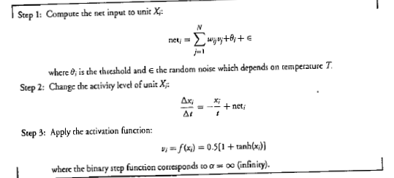
Gaussian Machine

Slide 14

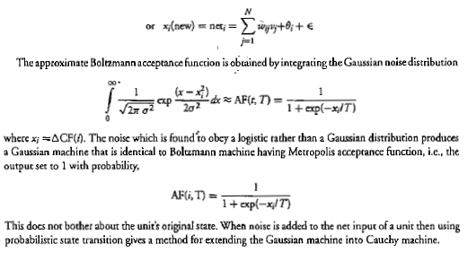

Slide 15
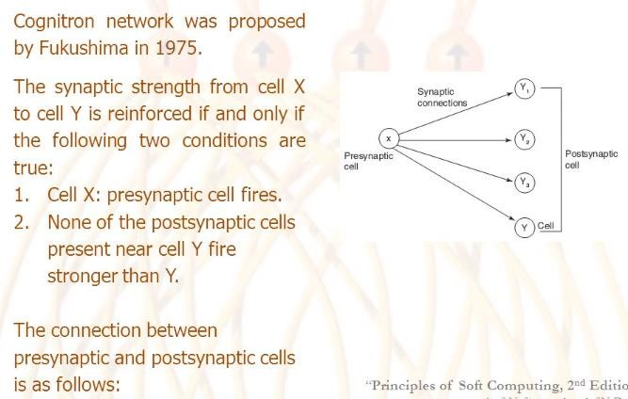
Cognitron Neural Network

Slide 16
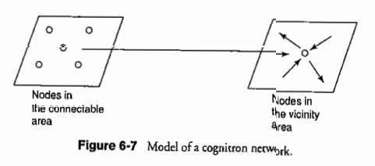
Model of Cognitron Neural Network
Application - Cognitron network can be used in neurophysiolog and psychology, visual and suditory information processing system.
visual

Slide 17
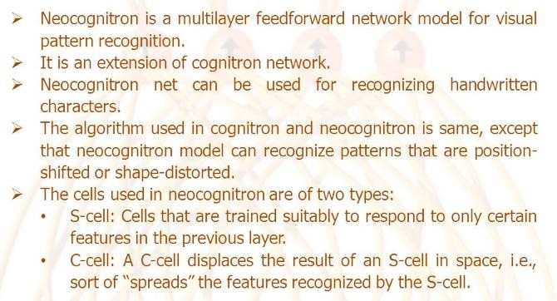
Neocognitron Neural Network

Slide 18
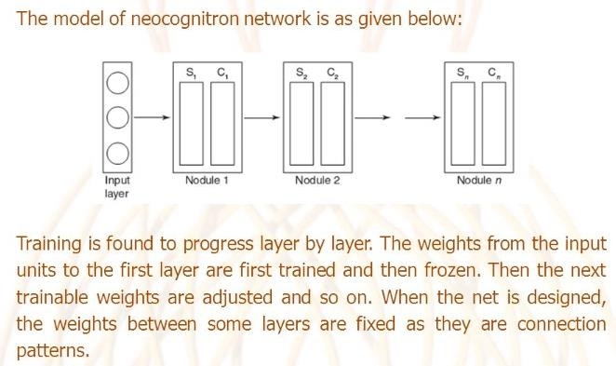
Neocognitron Neural Network

Slide 19
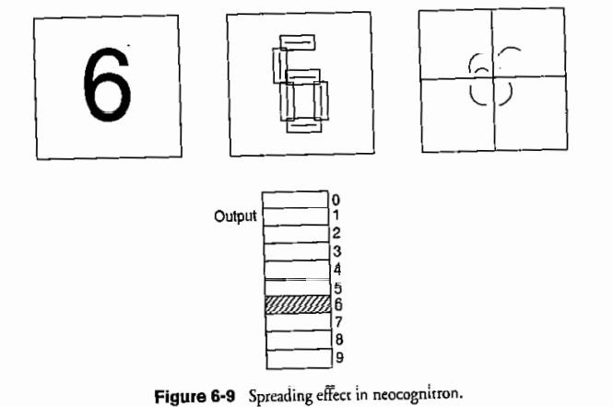
Neocognitron Neural Network
15

